Slide 1
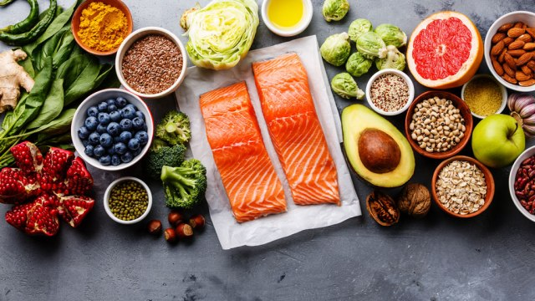
A HEALTHY LUNCH
by Kelly Hashway

Slide 2
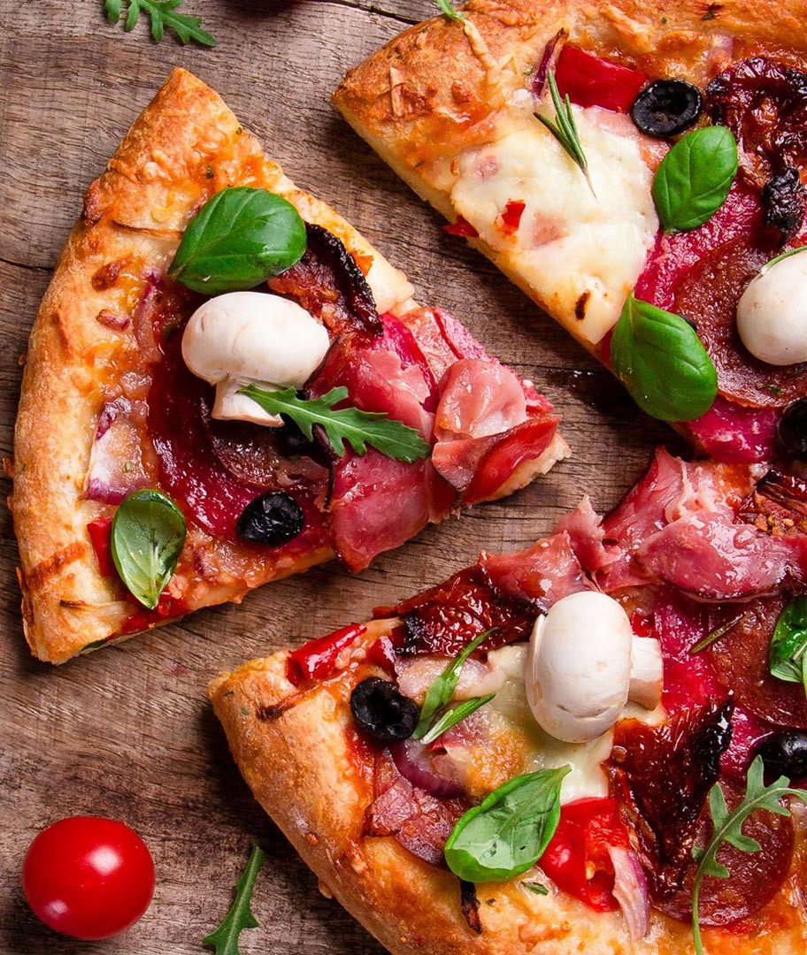
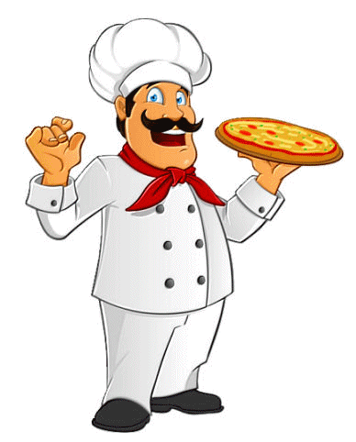
Alan took his tray of pizza and potato chips to his table and sat down across from Jared. “Check it out ,” Alan said. “I got the biggest slice!” Jared shook his head. “You eat way too much pizza.”
past tense of shake

Slide 3
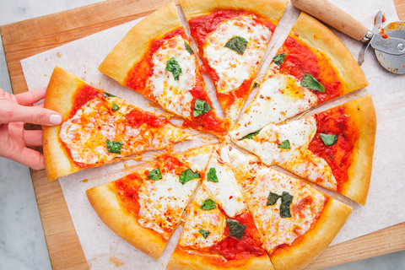
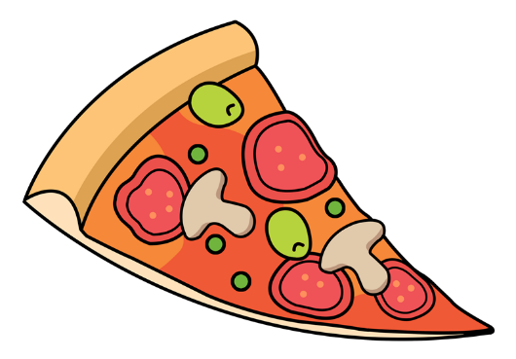
Alan scowled. “No such thing. It’s good.” . .“Yeah, but it’s not good for you.” Alan picked up his oversized slice, examining it closely. “What are you talking about? It’s got cheese and tomatoes. Those are both good for you.”
an expression that shows anger or disapproval
looking at something closely or carefully

Slide 4
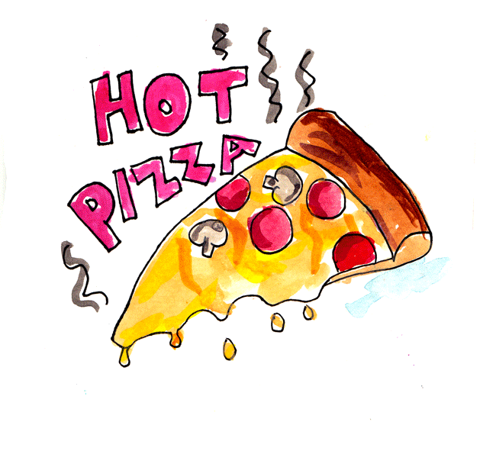
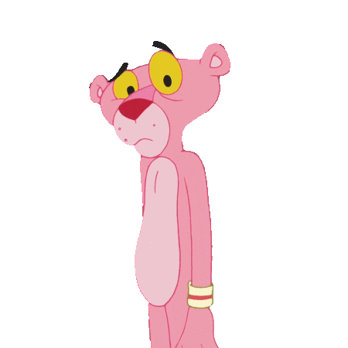
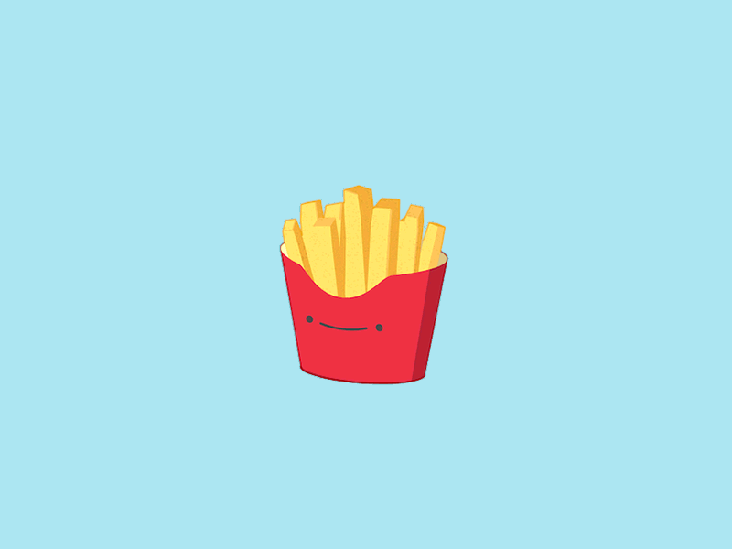
Jared tipped Alan’s hand, allowing the grease to drip down the slice of pizza and onto Alan’s plate. “Look at that grease. That’s bad for you.” Alan shrugged. “Whatever. I’m eating it.” He took a big bite and then picked up a potato chip. “See, potatoes are good for me, too.”
to move so that one side is higher than the other
an oily substance

Slide 5
Jared handed Alan a napkin. “Here, wipe your hand on this.” “Why?” Alan asked, furrowing his brow in confusion. “Just do it and you’ll see.” Alan popped the potato chip into his mouth and then wiped his hand on the napkin.
a facial expression that causes the skin on your face to wrinkle
to make a short sudden sound like a small explosion

Slide 6
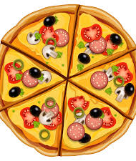
“Gross,” he said, seeing the big greasy smear. “Yeah, and there was plenty more grease on the chip you just ate.” Alan put his pizza back on the tray and pushed it away. “So what can I eat that still tastes good?”
serious
to spread a sticky substance across something

Slide 7
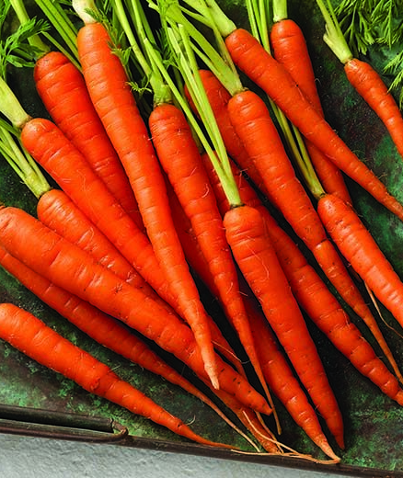
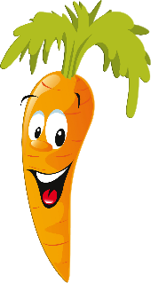
Jared handed his bag of carrots sticks to Alan. “Try these.” “Carrots? No thanks.” Alan shook his head. “Carrots are good for you and they taste good.” Jared motioned for Alan to eat one.
to make a movement, usually with your hand, that tells somebody what to do

Slide 8
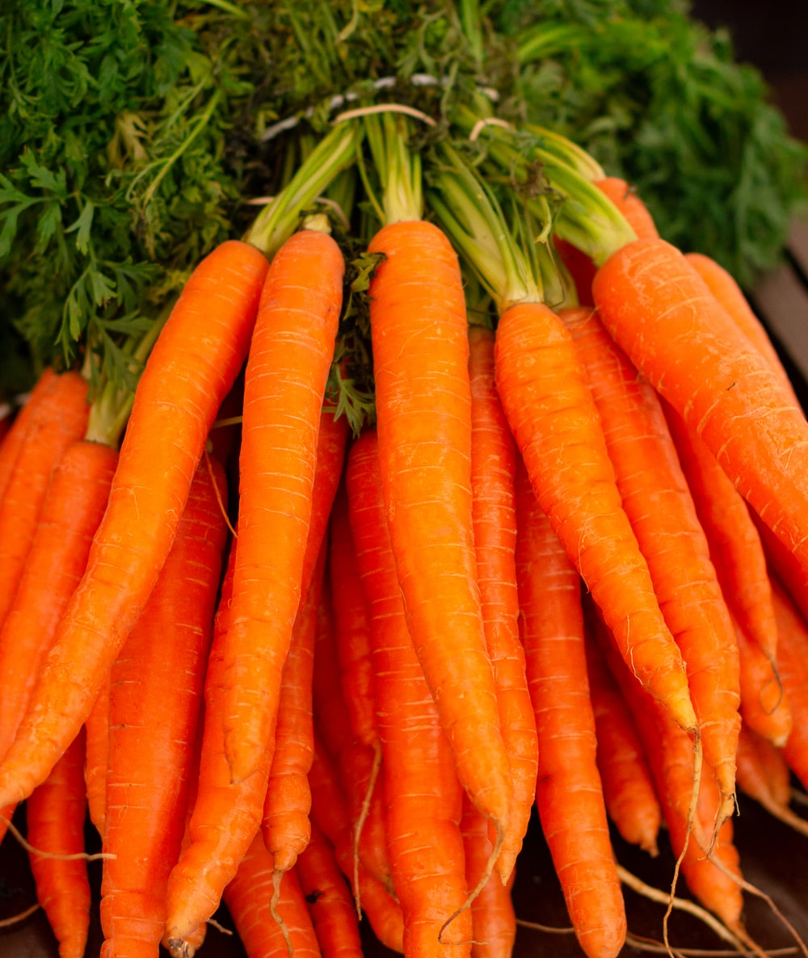
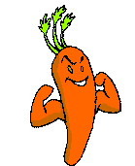
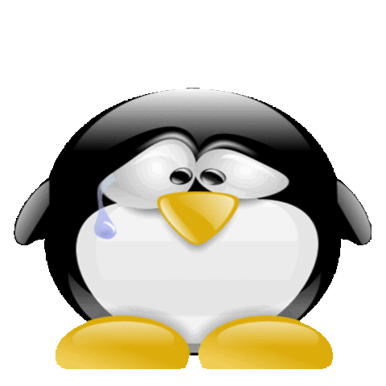
Alan sighed and tossed a baby carrot into his mouth. “Crunchy.” Jared smiled. “And tasty, too.” “Okay, fine, but I miss my pizza.”
to let out a long, deep breath that shows you are tired, sad, disappointed etc
to throw something lightly and carelessly

Slide 9
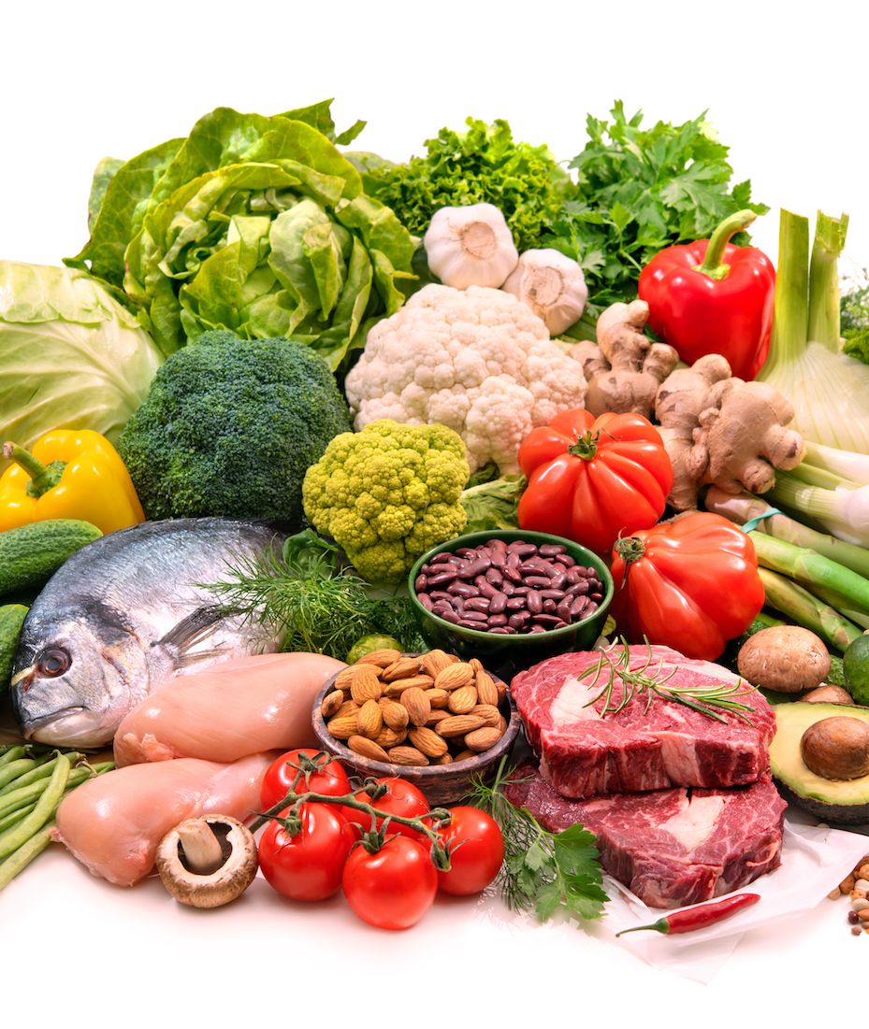
Jared took a napkin and dabbed the grease from the top of Alan’s pizza. “That’s a little better. But maybe you don’t need to eat the whole slice. Maybe you should eat some more carrot sticks and then have half of that pizza.”
to touch something with quick light touches

Slide 10
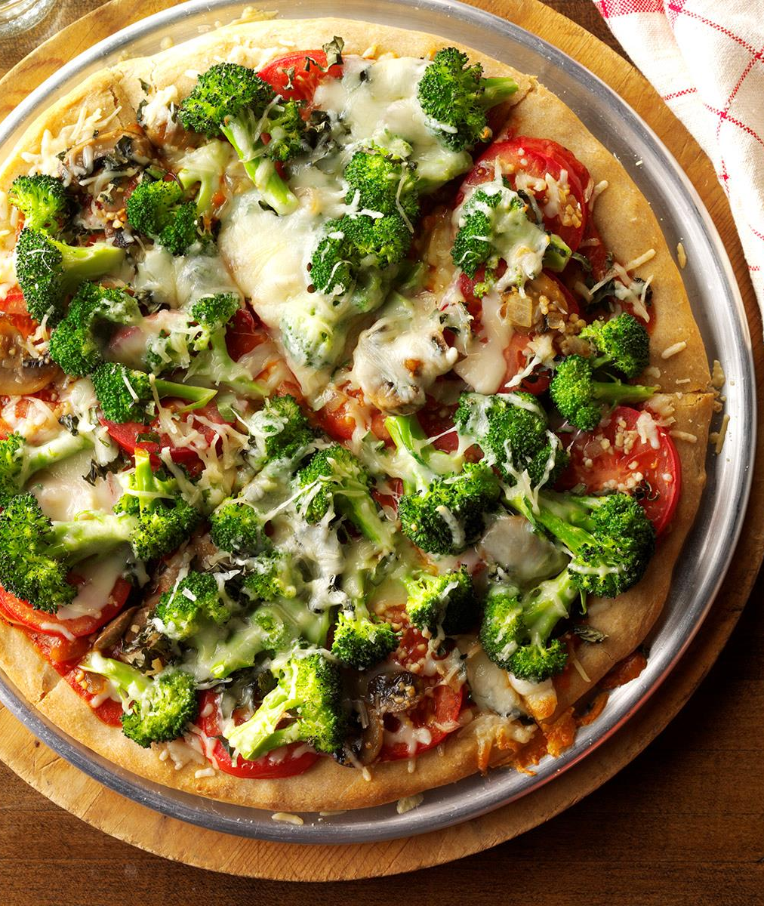
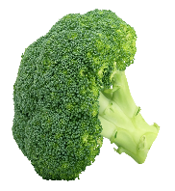
“Half?” Alan thought for a minute while he ate another carrot stick. “So I don’t have to give up all the foods I like. I just have to eat less of them and more of the healthy stuff.” Jared nodded. “Exactly. And next time, order broccoli pizza.” “I like broccoli, “Alan said.

Slide 11
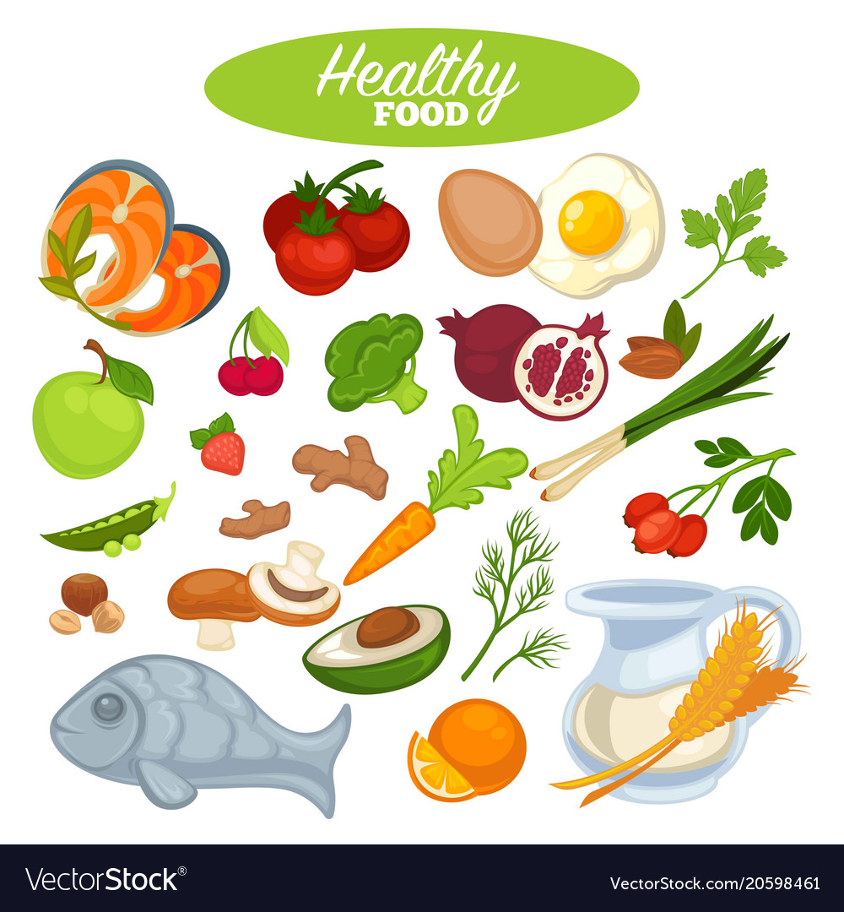
“Jared motioned to the bag of carrots. “Now, think I can get some of those? Alan laughed. “I’ll split them with you.” “Okay, but tomorrow, bring your own,” Jared said.

Slide 12
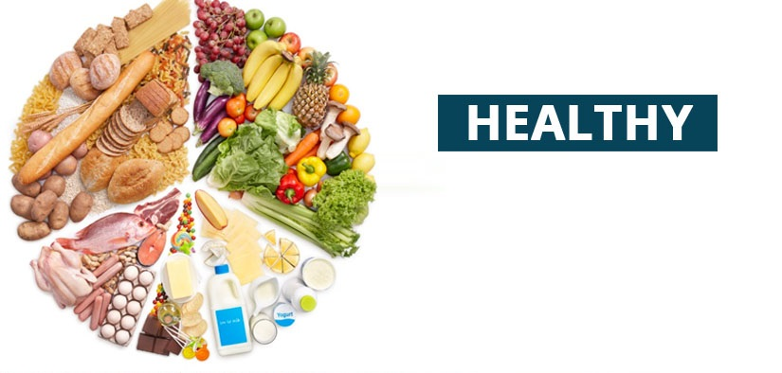
Answer the following questions
A
LUNCH

Slide 13
What is the title of the story?
Name the author of the story?
Where is the story taking place?
What is the story based on?
Name some healthier food you eat?

Slide 14
What did Alan have to eat with his pizza?
What was unhealthy about Alan’s pizza?
According to Jared, what were the three ways that Alan could make his pizza healthier?
At the end of the story, what food did Alan want to eat?

Slide 15

Food alphabet

Slide 16
Name some foods in ABC order
Example
A – Apple juice
B – Bread
C – Carrot rice
D – Donut…….

Slide 17
Riddle Time!!!
Guess the food items

Slide 18
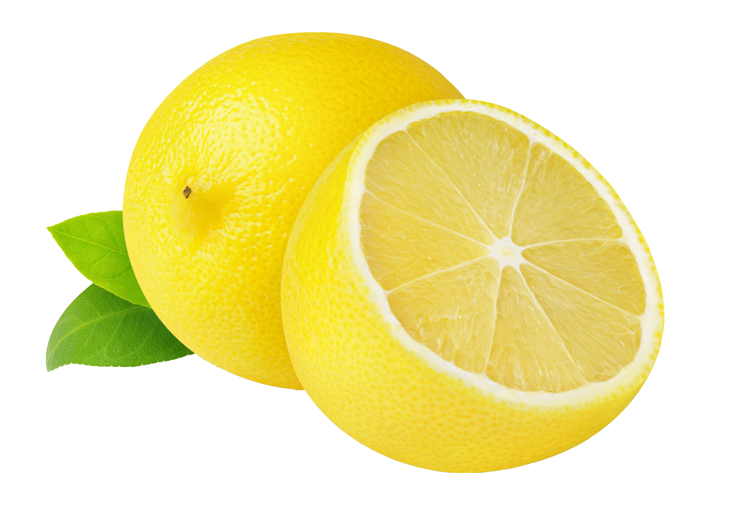
This is something yellow But it is not a light It is a citrus fruit That’s a flavor in Sprite

Slide 19
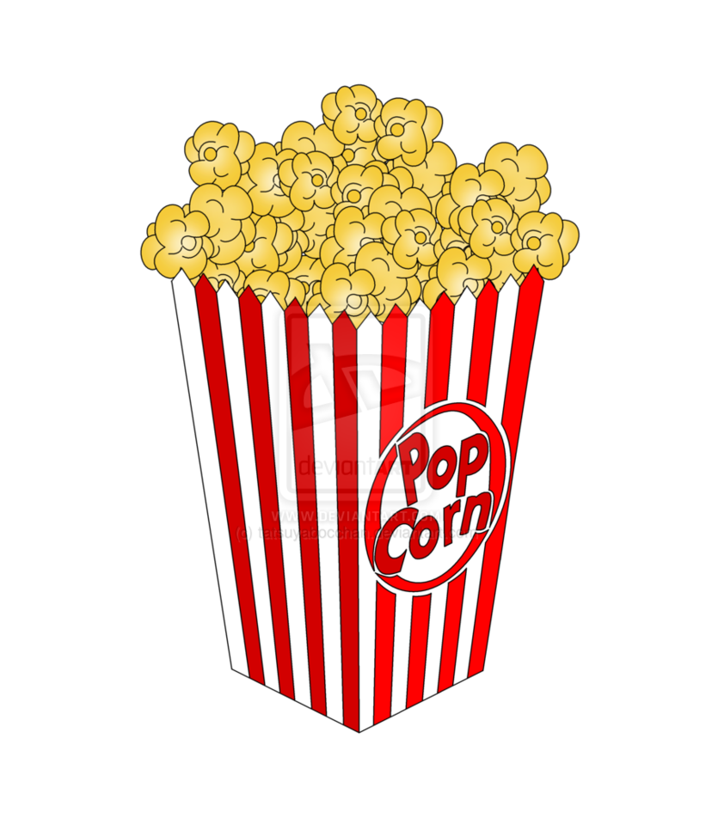
If you go see a movie You have to get some of this And then add butter or salt For a taste that’s simply bliss

Slide 20
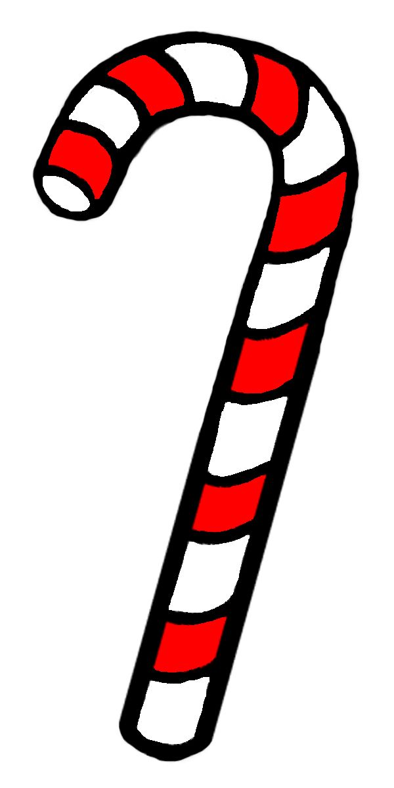
With red and white stripes It’s something you lick Despite it looking Like a hockey stick
Candy cane

Slide 21
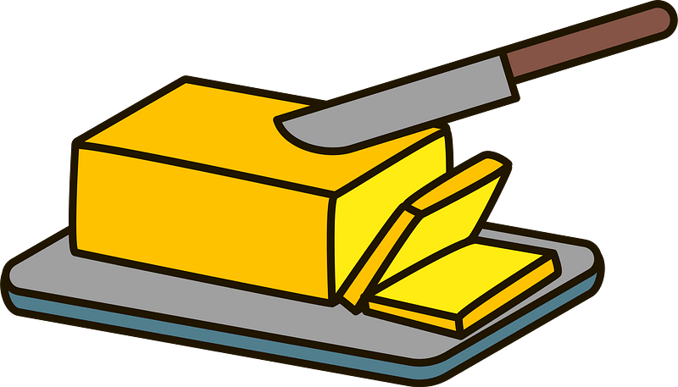
I can sometimes be a stick But I don’t come from a tree I can be spread on your toast I’m a product that’s dairy

Slide 22
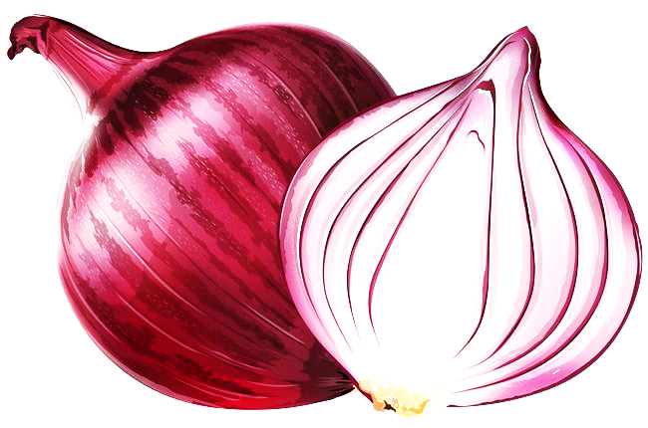
This is a stem That can be red, white or green It can make you cry a lot Even though it is not mean

Slide 23
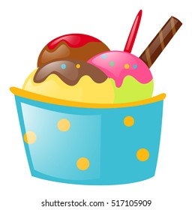
In a bowl you use a spoon On a cone you give a lick This frozen dairy dessert Many flavors you can pick

Slide 24
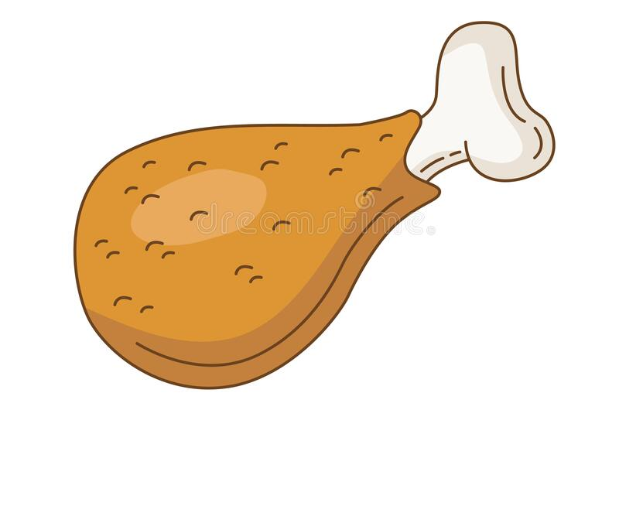
You can eat its wings Its breast and its legs Plus when it’s alive You can eat its eggs

Slide 25
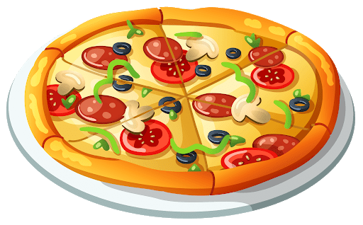
If you’re craving some fast food Then this thing might grant your wish It sometimes has a stuffed crust And sometimes it is deep dish

Slide 26
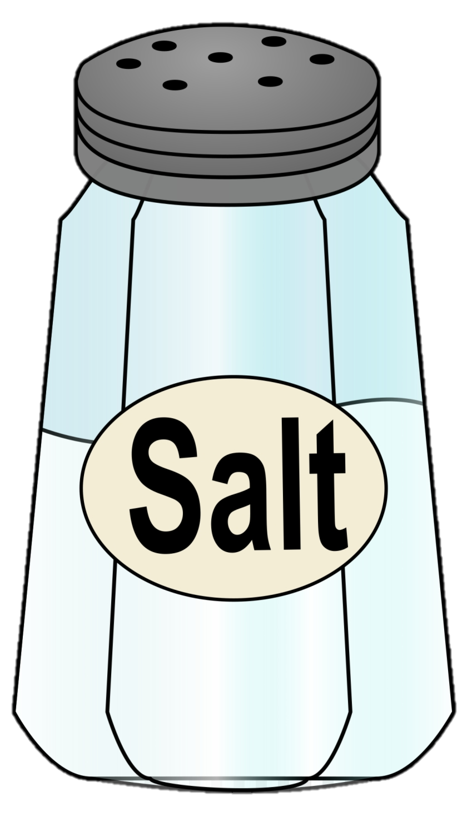
This thing comes as a small grain But it’s not sugar or sand It’s often used when cooking So that food doesn’t taste bland

Slide 27

I’m something that is sticky I’m something that is sweet I’m made by more than one bee I’m something that you eat

Slide 28
Healthy or Unhealthy!

Slide 29
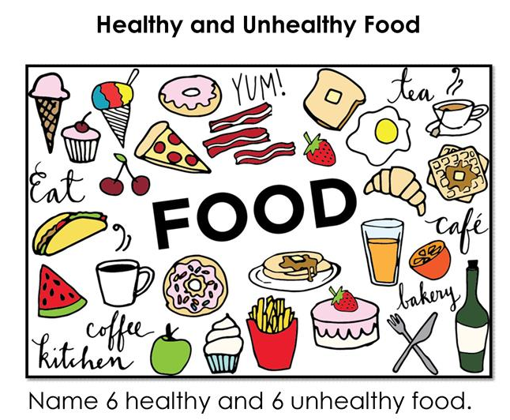

Slide 30
Guess the name of the fruit!

Slide 31
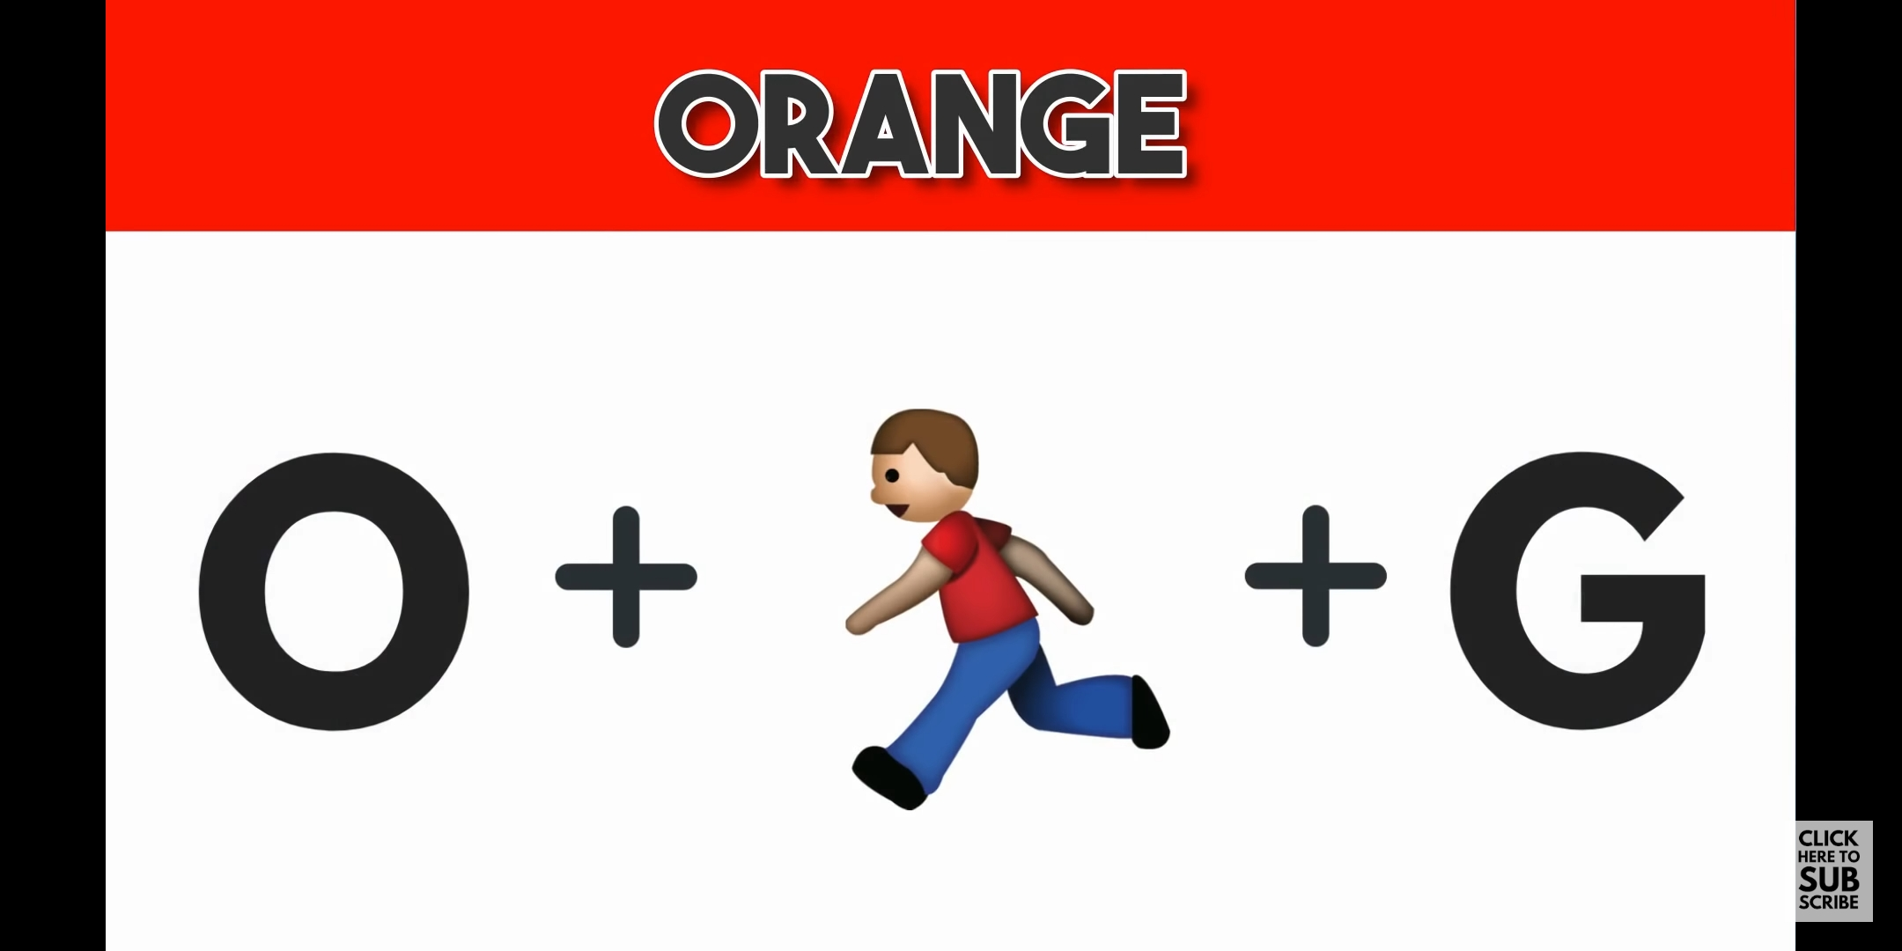

Slide 32
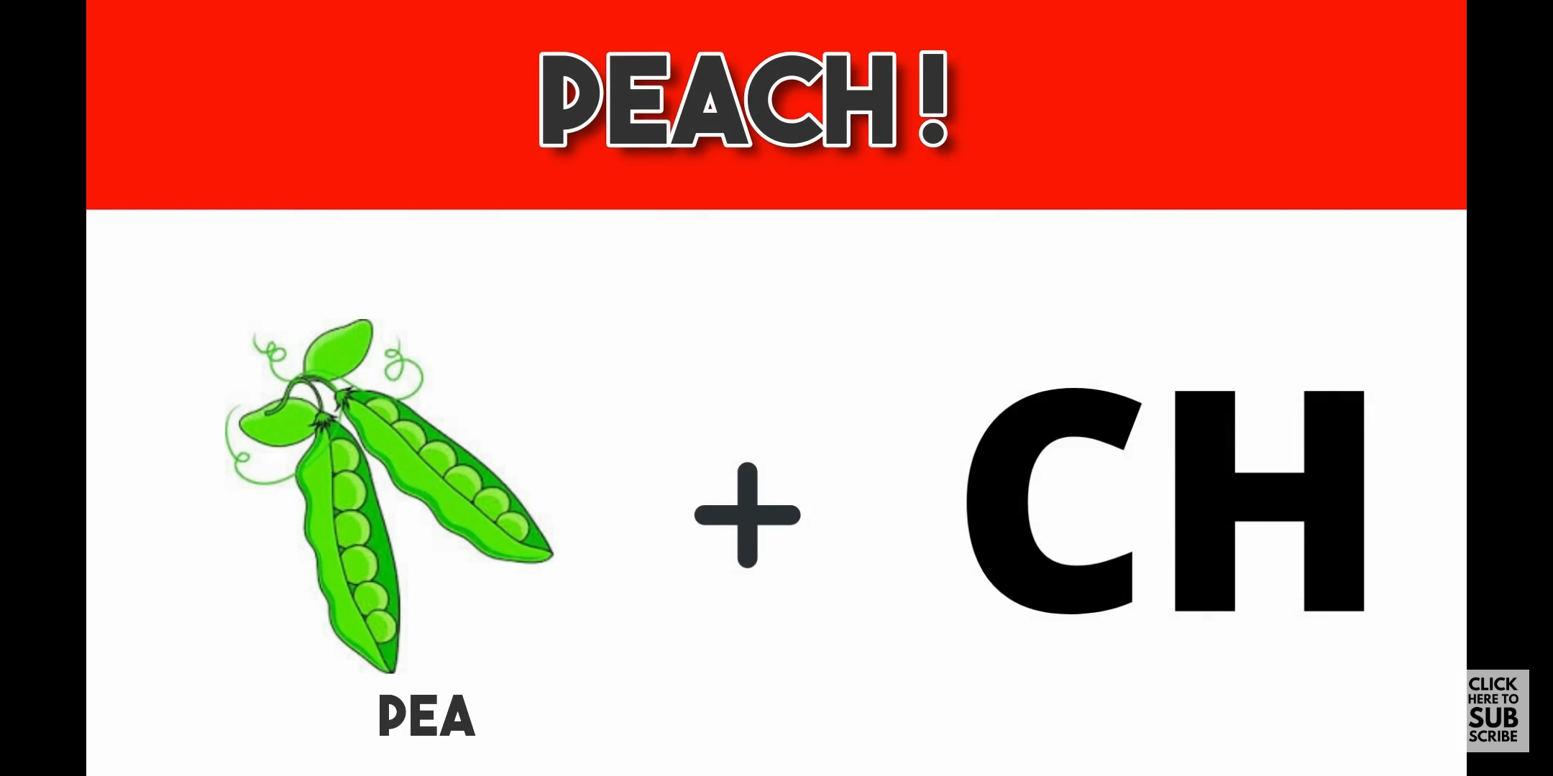

Slide 33
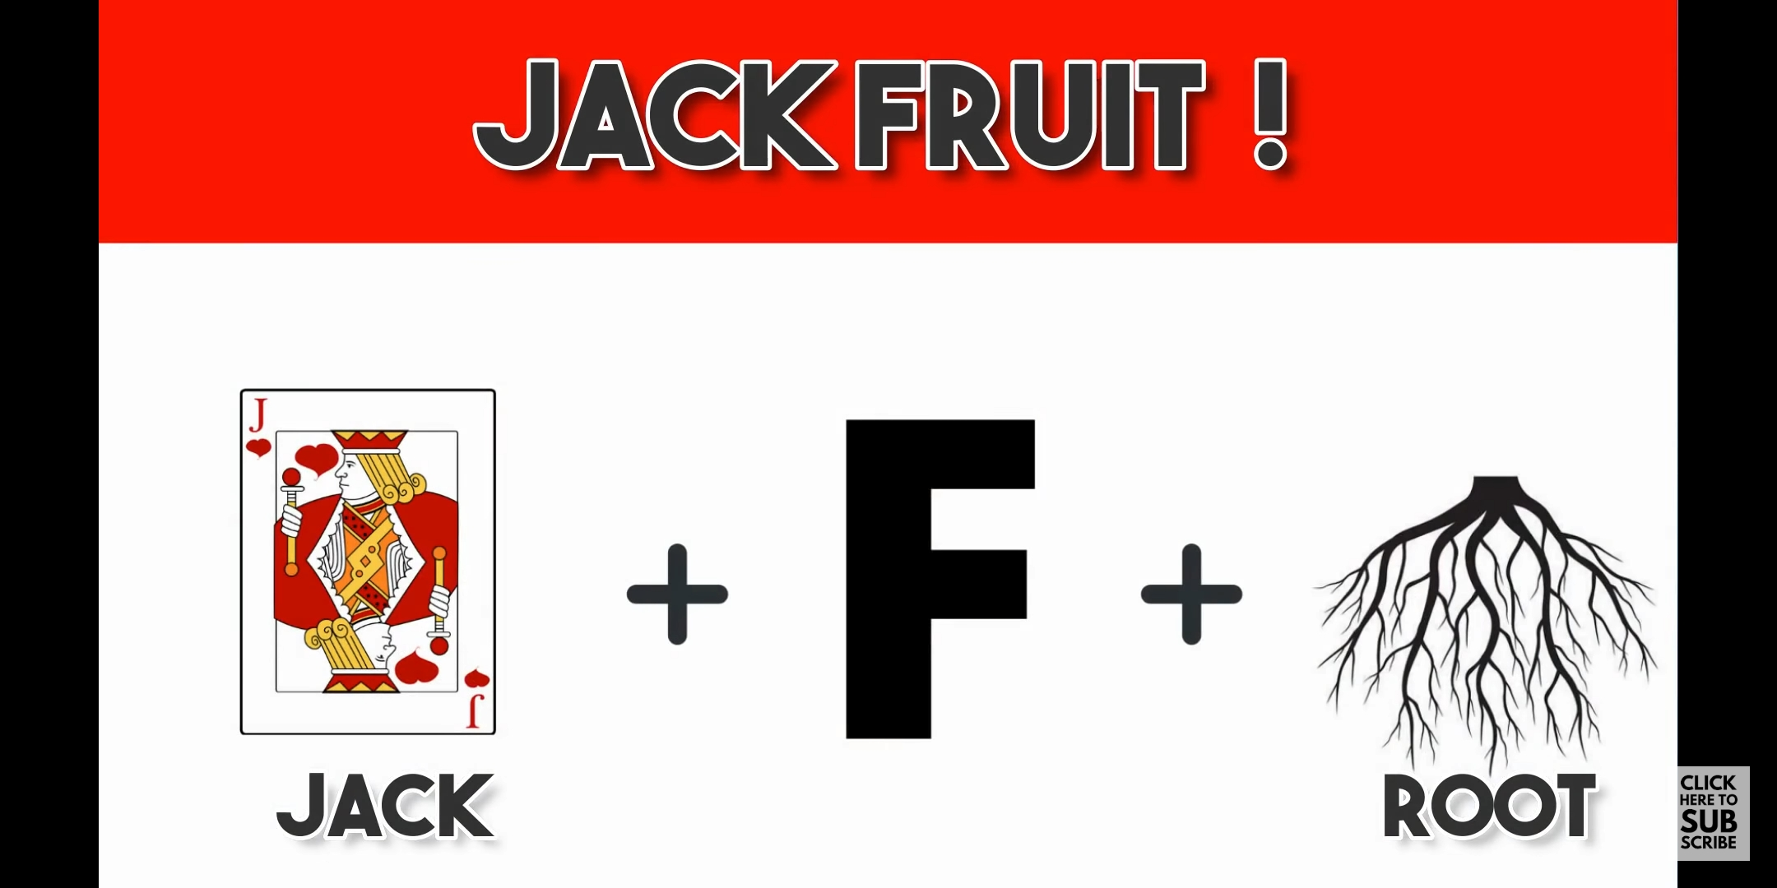

Slide 34
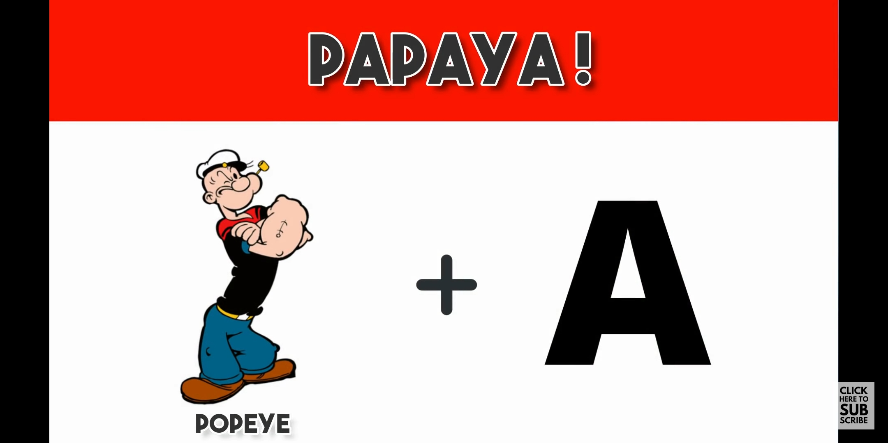

Slide 35
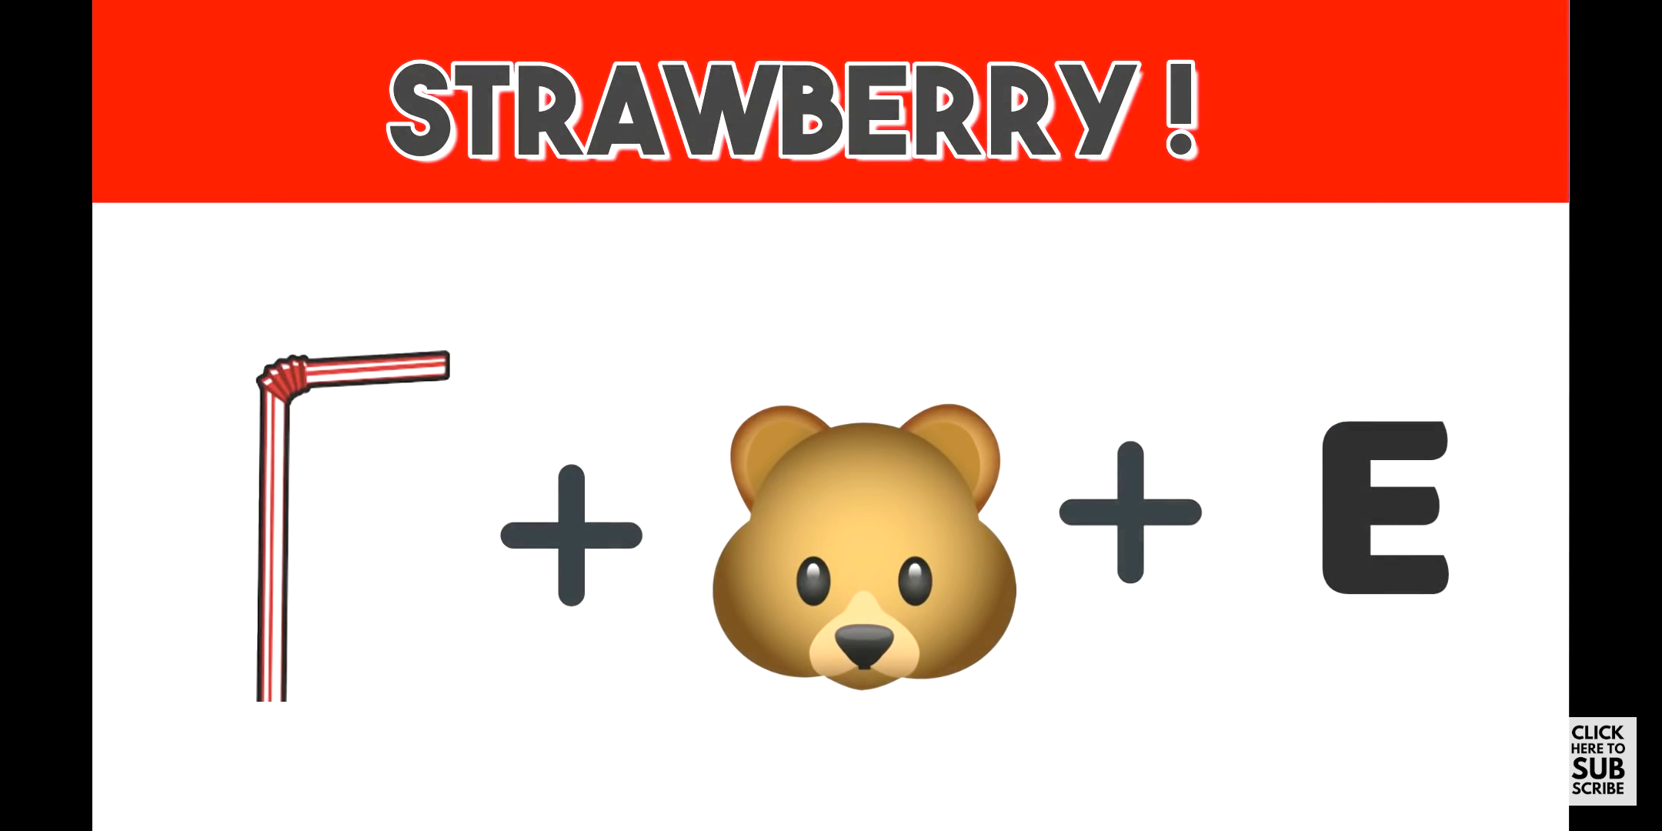
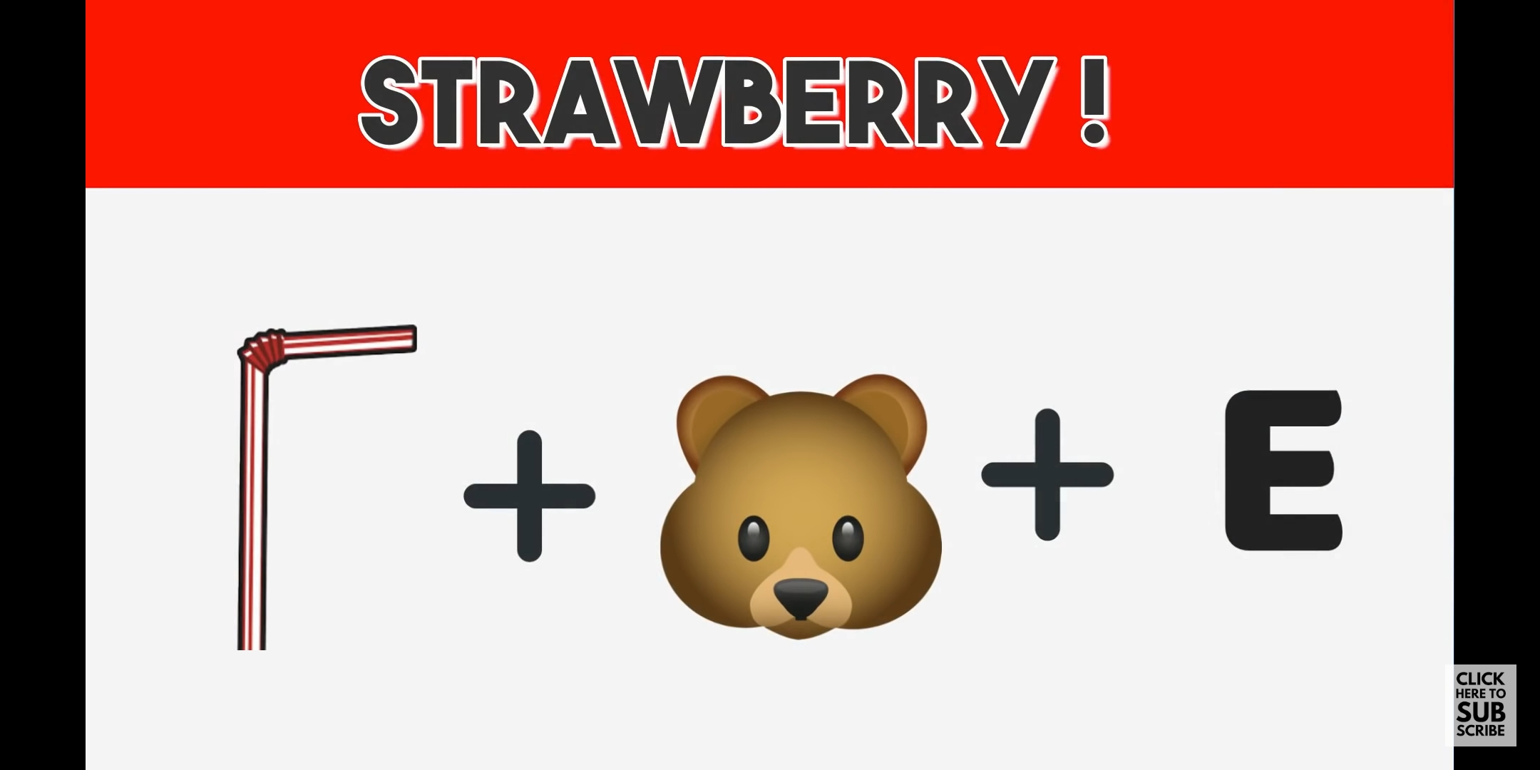

Slide 36
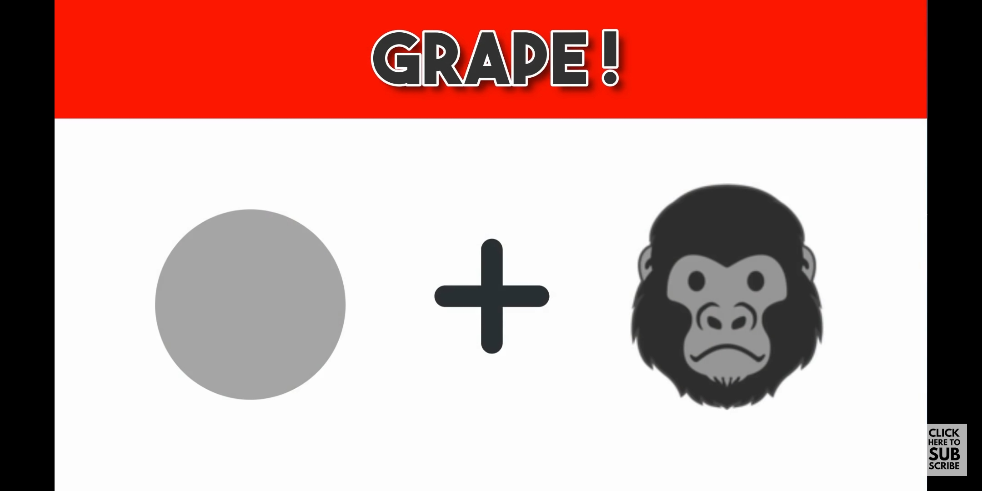

Slide 37
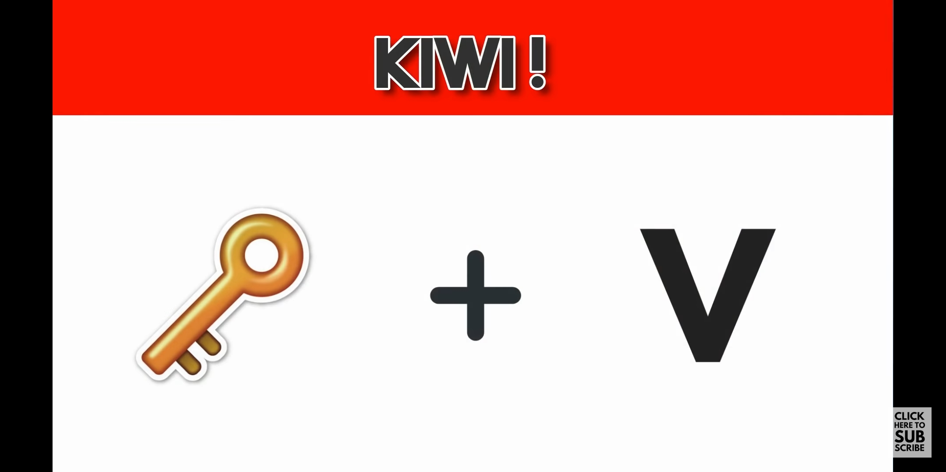

Slide 38
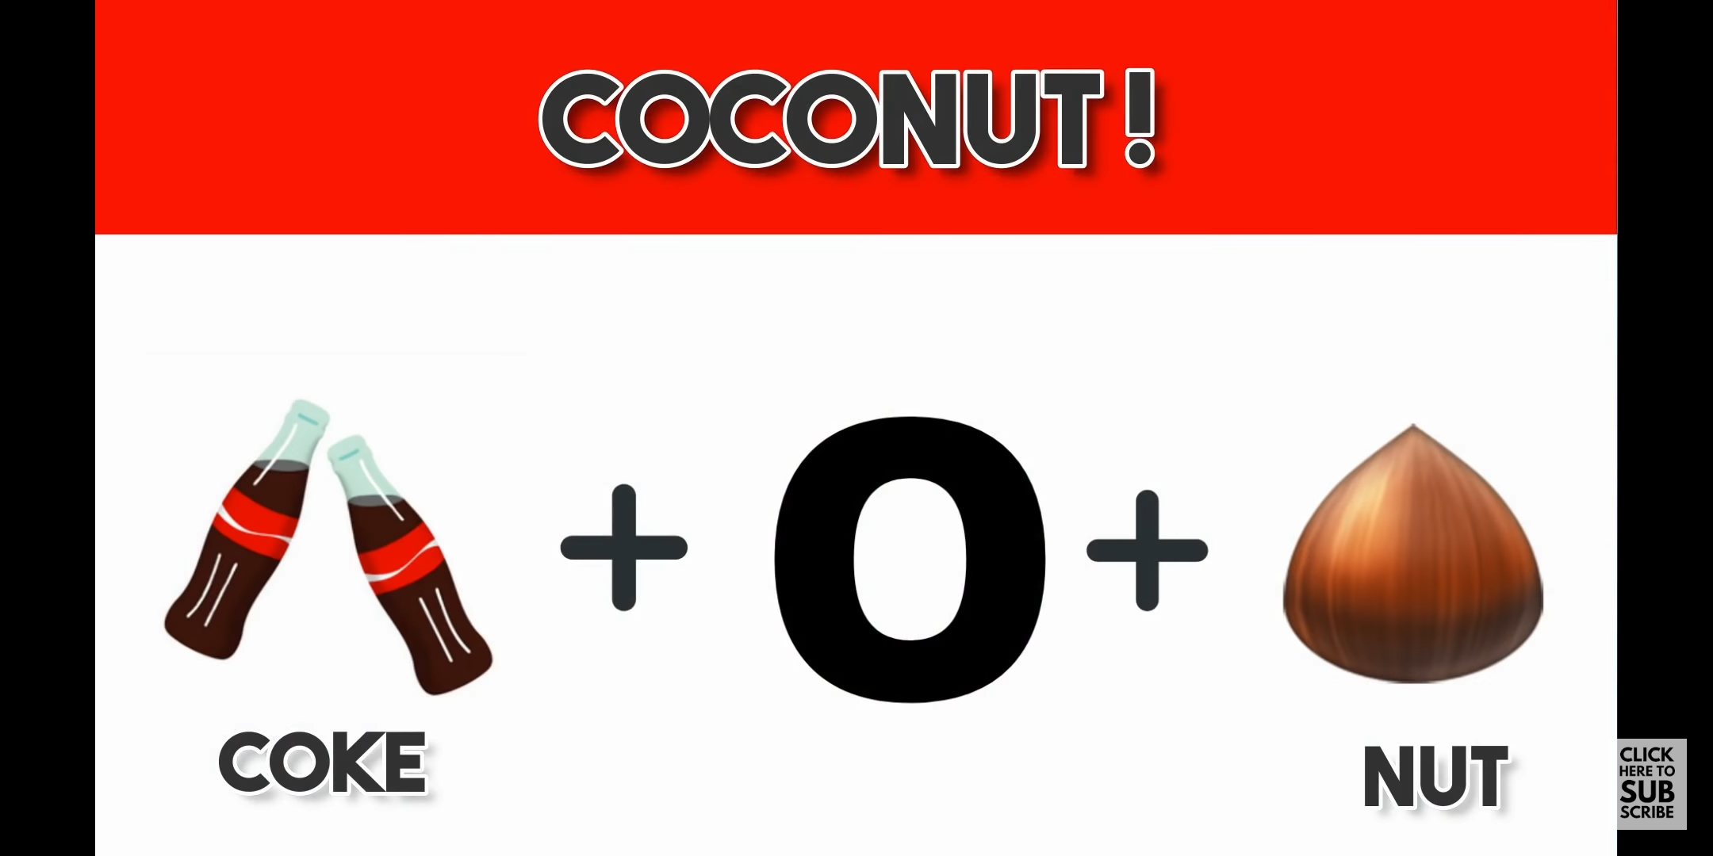

Slide 39
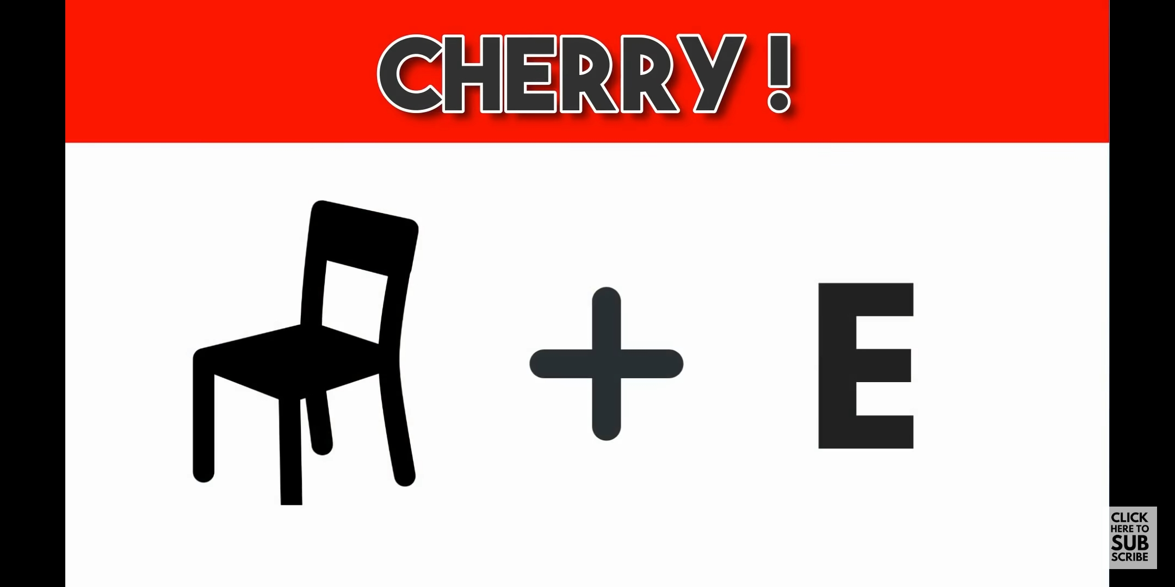

Slide 40
